Slide 1
Vaidyamitra – Online Ayurveda Aushadhalay
By:- Kedar N. aradhye

Slide 2
INTRODUCTION
“Vaidyamitra – Online Ayurveda Aushadhalay” In Online Sales for Aayurvedic Medicine, We have tried to provide online sales ayurvedic medicine which are being used in creating Mobile Application. This is Application is very easy to use and gives friendly environment to our customers. The customer can see the ayurvedic medicine and can buys.
Ayurveda is one of the effective forms of medicine that is present in the world. The online ayurvedic application will give the details of the ayurvedic products with great.
You can even login from that page. Without login user cannot purchase any Product. For new user we have given the facility for sign in.But User Views Ayurvedic Products.
This will be one of the applications that will help the customers to buy the ayurvedic products with great Features. The user interface must be simple and easy to understand.
Not even the ayurvedic products even the Ayurvedic medicines, Ayurvedic books, Ayurvedic Instruments can be sold through this application.

Slide 3
FEATURES
Vaidyamitra – Online Ayurveda Aushadhalay is extremely important Mobile Application. Many features are here,
1. Manage multiple Products from a single Mobile .
2. Total computerized system.
3. Effective use of time.
4. Cost Effective.
5. 24*7, anytime availability.
6. Customer getting Quality Ayurvedic Products.
7. User Friendly Application.
8. Provide Filters.

Slide 4
SCOPE
There is an Admin panel which has an authority to manage all data like Add Products, Update Products, Delete Products, Display Order Details and Manage Products,Manage Login for Doctor, Ayurvedic Medical Shops,Medical Students,etc.Admin Panel is Available Only in Web Application.
In our system we can add new Vendor and manage it all things.
Products Price,Quantity can manage by admin.
Manage Login for Doctors,Medical Students And Ayurvedic Medical Shops will be managed by admin.
Customer needs to register to become the member of Application.

Slide 5
MODULES

Slide 6
1. Login Module:-
Once user create account he can login with username and password for place Ayurvedic products order. If new user then need to register first Goto the Registration Page.
2 . Product Selections Details:-
In this step, Registered new users Get all details about Products means user is doctor to get doctor ID,if user is Medical Store then get medical license details,if user is student to get college ID Card photo.
3. Order detail Module:-
In this module After the selection of Ayurvedic product in next screen must have enter the quantities of item.

Slide 7
4. My Cart Details:-.
In this module Product Selected then Click on Add to Cart And then Goto Select Payment Mode Done Payment.
5. Payment Details:-
Firstly select payment Mode like as Debit Card,Credit Card,Net Banking Or UPI. then,Display all the payment details which is entered by user Username, payable amount, bank name,cvv.
6. Display Orders Details:-
This screen shows all the current orders to your cart.user will delete order when the product not purchase Or Admin Panel Displays Order Details Or Product Details .
Data is stored with the help of software and filed with easy in the computer database.

Slide 8
SOFTWARE REQUIREMENTS for Developers
Operating System : Windows XP/2007 or Linux
Coding Language : Java, Android, XML
Database : SQLite, SQL Server
IDE : Android Studio .

Slide 9
Hardware Requirements for Developers
Processor : Intel i3
Hard Disk : 250GB
RAM : 2GB or more

Slide 10
SOFTWARE REQUIREMENTS for system
Operating System : Android 4.4 & Above
ToolKit : Android Development Toolkit(Android Studio
Platform : Java & Android
Database : SQLite.

Slide 11
Hardware Requirements for System
Mobile : Android Mobile
Mobile Device Version : Above Version 4.4(Kitkat)
RAM : 2GB or more

Slide 12
DIAGRAMS

Slide 13
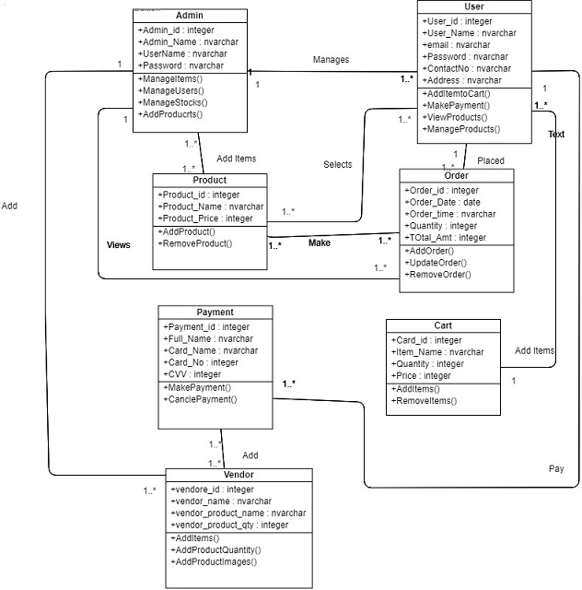
CLASS DIAGRAM

Slide 14
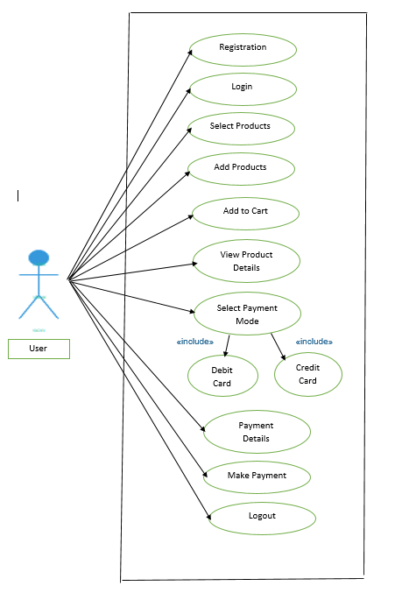
Use Case (USER)

Slide 15
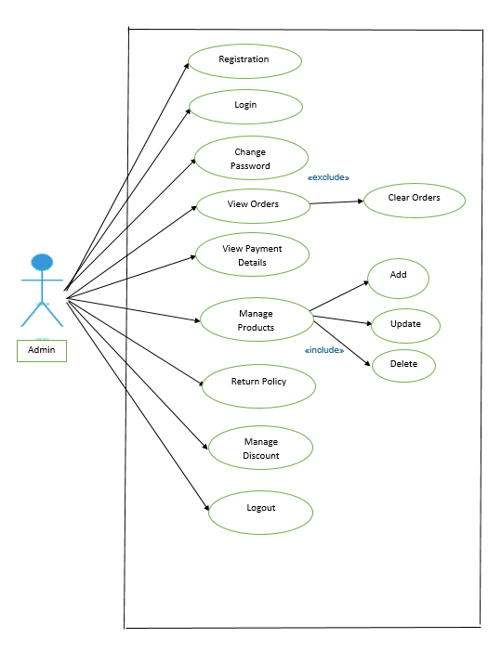
Use Case (ADMIN)

Slide 16
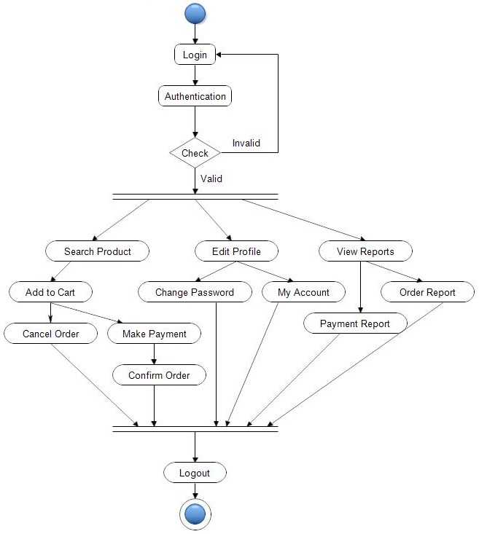
ACTIVITY (USER)

Slide 17
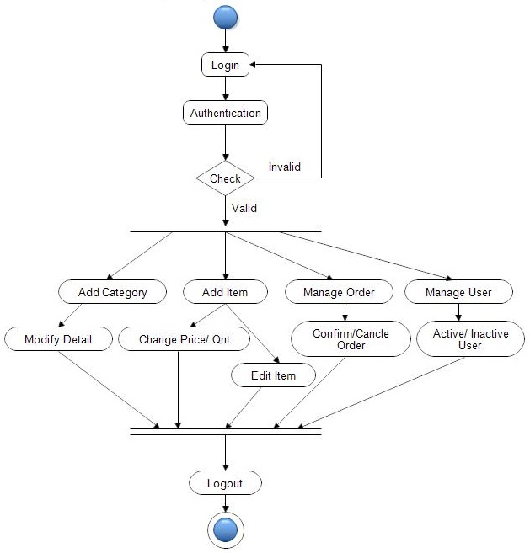
ACTIVITY (ADMIN)

Slide 18
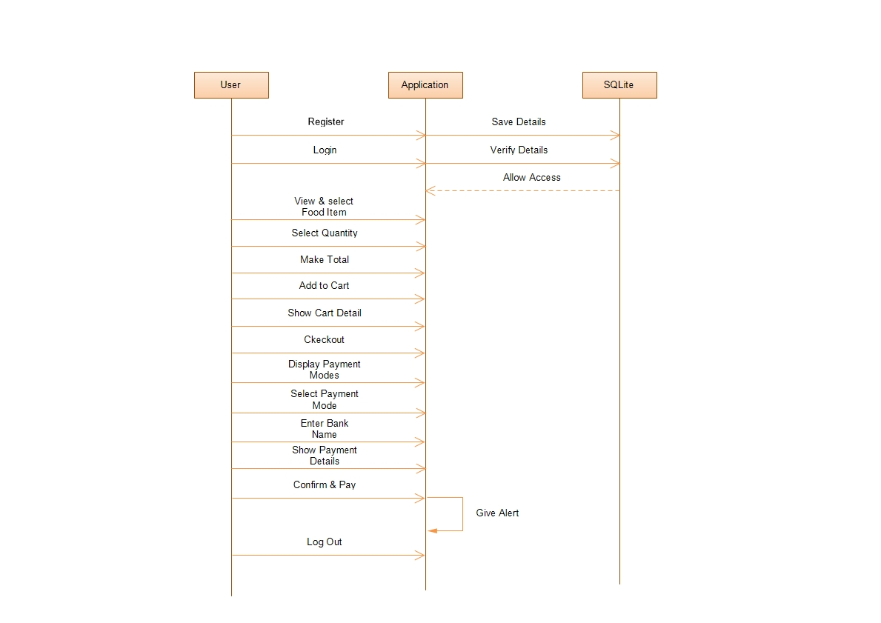
SEQUENCE(USER)

Slide 19
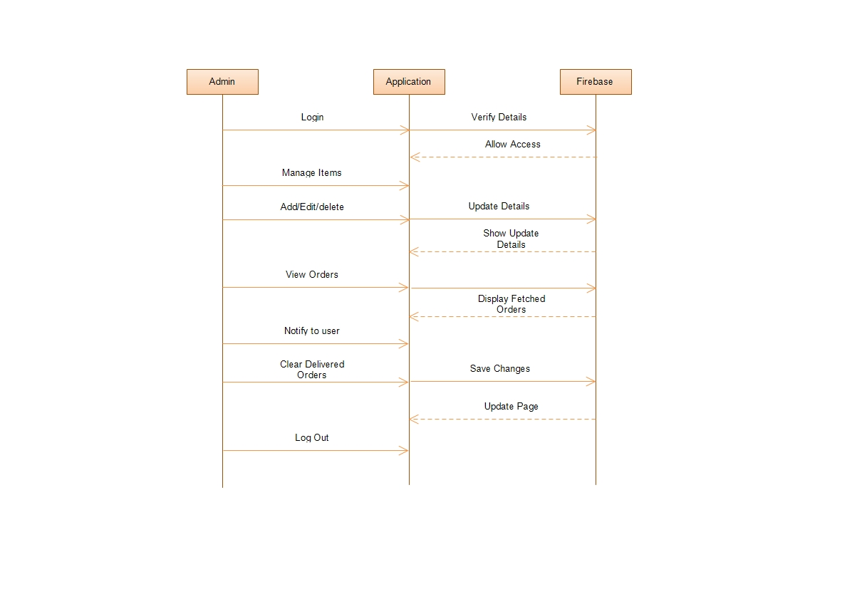
SEQUENCE(ADMIN)

Slide 20
SCREENSHOT

Slide 21
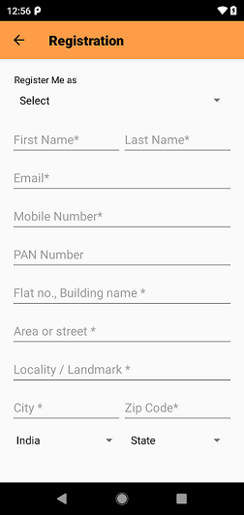
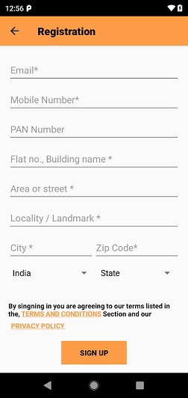
REGISTRATION

Slide 22
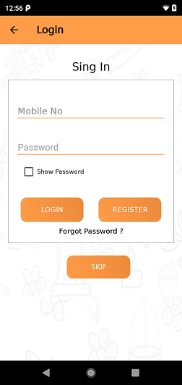
LOGIN

Slide 23
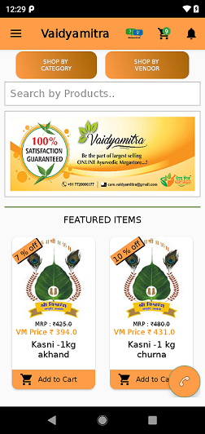
Home Page

Slide 24
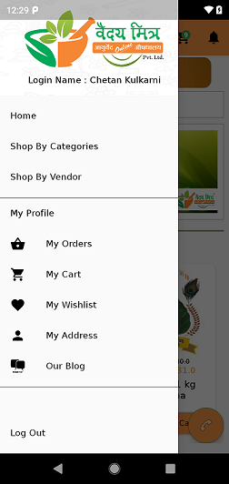
Navigation drawer

Slide 25
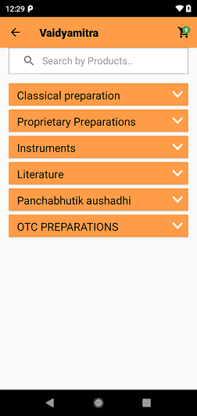
Category Page

Slide 26
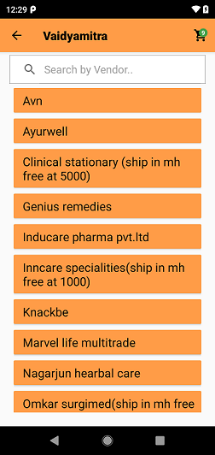
Vendore wise Category

Slide 27
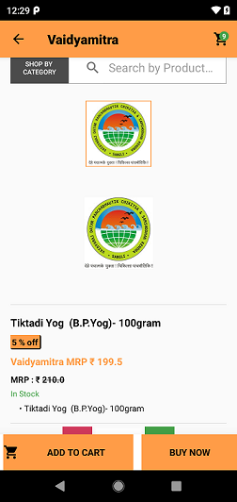
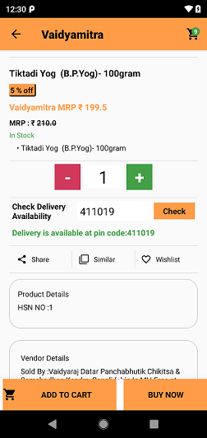
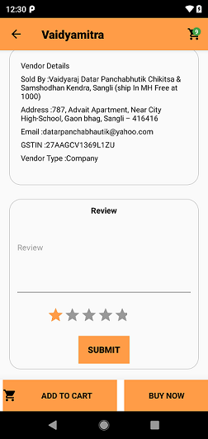
Product Detailed Page

Slide 28
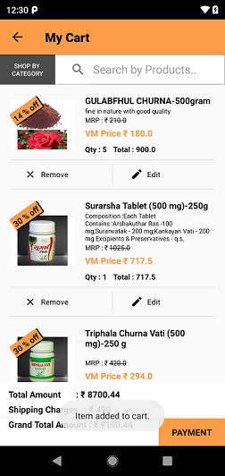
Cart Page

Slide 29
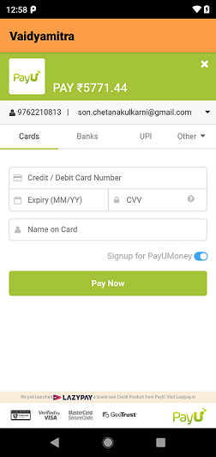
Payment Page

Slide 30
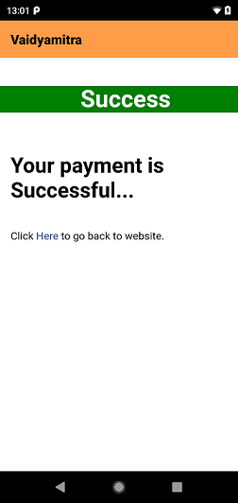
Payment Successfully

Slide 31
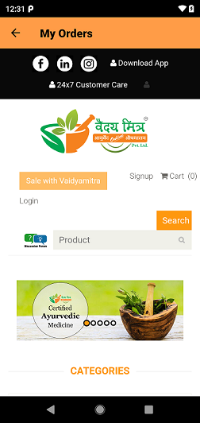
My Order Page

Slide 32
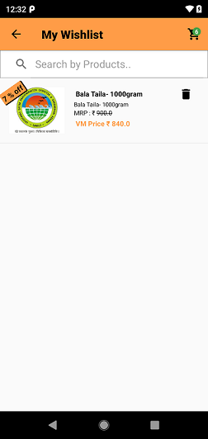
My WishList

Slide 33
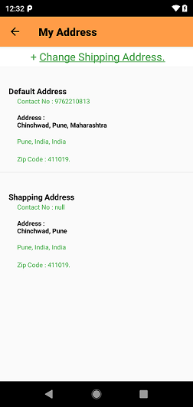
My Address Page

Slide 34
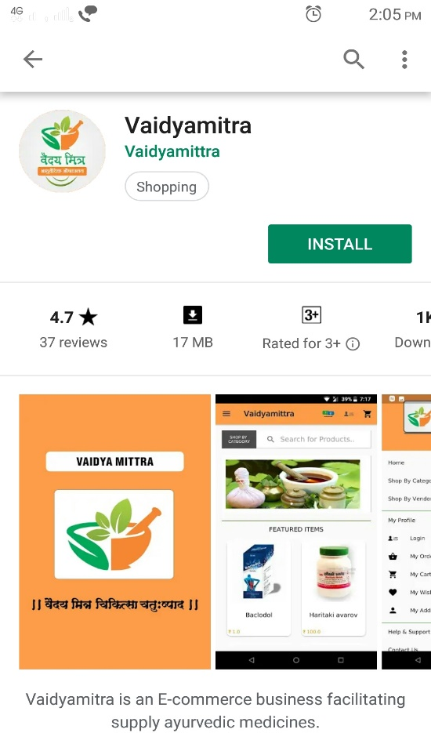
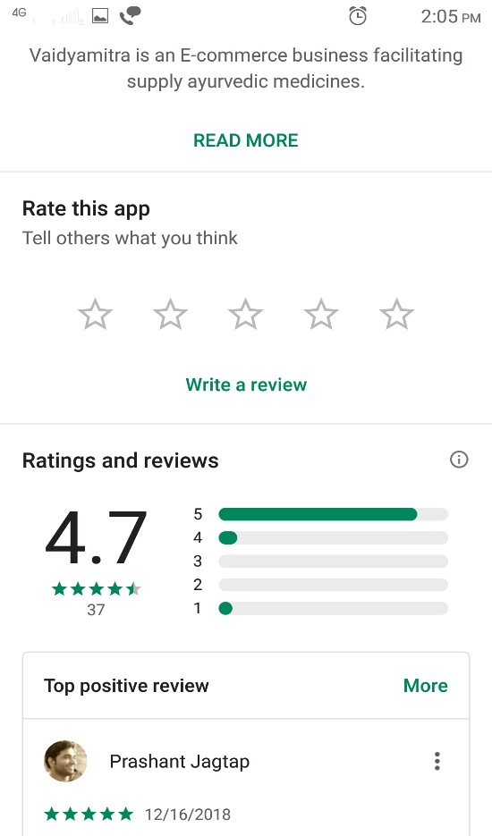
Play Store
This Application Will be Available on Play Store,So Any User Can Install it And Used it. At 24*7

Slide 35
Proposed Enhancement
We Add Tracking Sytem About Products.
We Can Chat about Vaidyamitra Customer Care if Any Problem About Products Or Any Other Issues.
We Can Add Push Notifications Services.

Slide 36
biblography
Android And SQLite :-
www.developers.android.com
www.android.com
www.stackoverflow.com
www.sqliteonline.com

Slide 37
THANK YOU..!!!!!!

